Slide 1

Modeling for a Tradable Signal
Spinnaker Analytics
Team B5:
Lujain Alqassar
Yesol Lee
Ta-Wei Wang
Shrey Sood
Yilun Wang
Notes:
Allen

Slide 2
Table of Contents
01
02
03
04
Project Overview
Initial Exploratory Data Analysis
Business Plan
Models Built
05
06
07
Model Results
Limitations
Recommendations & Conclusion
Notes:
Allen

Slide 3

Project Overview
01
Notes:
Allen

Slide 4

Objective
Finding a tradable signal in the dataset that can be used for determining whether to buy or sell a stock portfolio in the future.
We want to minimize the risk and maximize the profit of the investments.
Notes:
Allen

Slide 5

Possible Uses of Our Results
Used by investment companies to better manage their customer’s portfolios.
Used by individual investors to help them better understand when to buy or sell a stock/portfolio.
Monitoring the market conditions of the current market.
Notes:
Allen

Slide 6
Datasets
Notes:
Allen

Slide 7
Dataset Introduction
Three datasets:
Institutional Mutual Fund Holdings (10668 rows)
Investments made by institutional investors like Fidelity
Retail Mutual Fund Holdings (11017 rows)
Investments made by individuals in their portfolios
ETF (11003 rows)
Exchange Traded Funds
Intersected rows: 10625 rows
Time Duration:
Jan 4th, 2006 - Feb 1st, 2017
579 weeks
Notes:
Allen

Slide 8

Dataset Introduction
Columns:
ReportDate: Date of record aggregating to every Wednesday
AssetClass: The Sector/ Industry/Asset Class
Flow: Amount of inflow/outflow in Millions of USD
FlowPct: Flows as percent of assets
AssetEnd: Assets at end of the week in Millions of USD
PortfolioChangePct: Percent change in overall portfolio in a week
Notes:
Allen

Slide 9
Dataset Introduction
Asset Classes:
Commodities/Materials-North America-USA-North America-Equity
Consumer Goods-North America-USA-North America-Equity
Energy-North America-USA-North America-Equity
Financials-North America-USA-North America-Equity
Health Care/Biotech-North America-USA-North America-Equity
Industrials-North America-USA-North America-Equity
Infrastructure-North America-USA-North America-Equity
Large Cap Blend-North America-USA-North America-Equity
Large Cap Growth-North America-USA-North America-Equity
Large Cap Value-North America-USA-North America-Equity
Mid Cap Blend-North America-USA-North America-Equity
Mid Cap Growth-North America-USA-North America-Equity
Mid Cap Value-North America-USA-North America-Equity
Real Estate-North America-USA-North America-Equity
Small Cap Blend-North America-USA-North America-Equity
Small Cap Growth-North America-USA-North America-Equity
Small Cap Value-North America-USA-North America-Equity
Technology-North America-USA-North America-Equity
Telecom-North America-USA-North America-Equity
Utilities-North America-USA-North America-Equity
Notes:
Allen
Large Cap → Large market capitalization (Market value — over $10 billion)
Mid Cap → Mid market capitalization (Market value—between $2 and $10 billion)
Small Cap → Small market capitalization (Market value — under $1 billion)

Slide 10

Initial Exploratory Data Analysis
02
Notes:
David

Slide 11
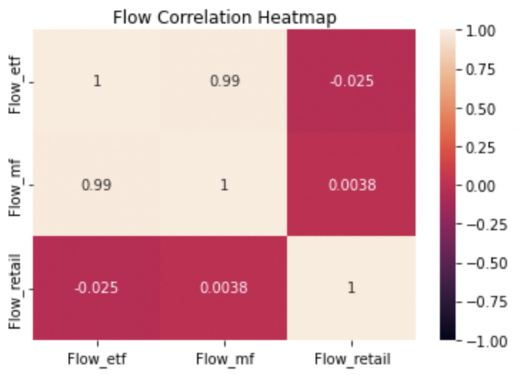
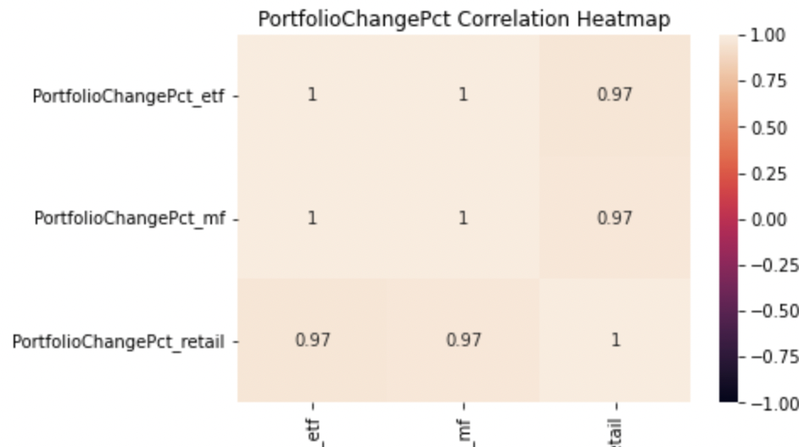
Merged Dataset
Heatmap for ‘Flow’ and ‘PortfolioChangePct’
Institutional Mutual Fund and ETF have a higher correlation.
PortfolioChangePct: All three align with each other with a near 1 correlation
Notes:
David

Slide 12
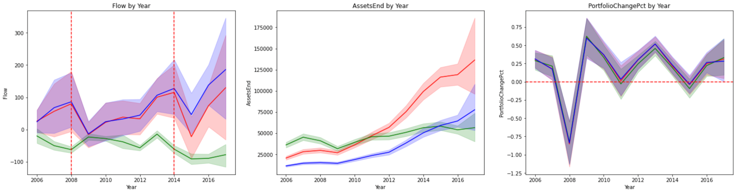
Merged Dataset
Lineplots by Year
Red: Institutional Mutual Funds
Green: Retail Mutual Funds
Blue: ETF
Institutional mutual fund and etf increased while retail mutual funds decreased
Two obvious decreases
2008: Global Financial Crisis
2014: Russian Financial Crisis
Notes:
David

Slide 13
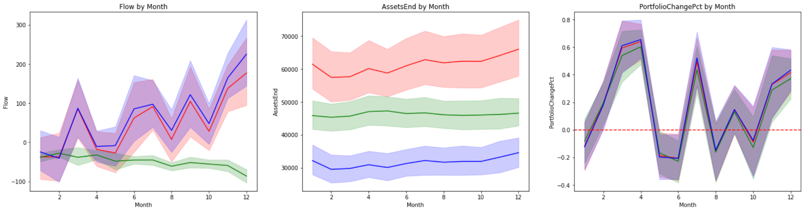
Merged Dataset
Lineplots by Month
Red: Institutional Mutual Funds
Green: Retail Mutual Funds
Blue: ETF
Flow increases from Jan. to Dec. for Mutual Funds
‘PortfolioChangePct’ are more uniformed
Higher percentages around March, April, and December
Notes:
David

Slide 14

Business Plan
03
Notes:
David

Slide 15

Business Plan Statement
Whether to buy/sell a portfolio due to the relationship between FlowPct and Assetsend to PorfolioChangePct.
Notes:
David

Slide 16

Models Built
04
Notes:
Sally

Slide 17
Models Built
<Modeling Categories>
Classification models
Predict next week’s tradable signal by using this week’s data
2 approaches, aggressive and conservative, with different cut offs
Aggressive approach baseline: 5%
Conservative approach baseline: 3%
Linear Regression models
Predict next week’s PortfolioChangePct by using other variables of past week
Neural Networks
Predict next week’s PortfolioChangePct with the merged dataset
Time Series models
Predict variables by using historical data of the variables in the dataset
Notes:
Sally

Slide 18

Models Built
<Classification Model>
Tried out 4 different classification models
Target variable: Tradable signal of next week
Predictor variables: flow, flow_pct, asset end, 20 asset class indicators
Predicted based on maximum class probabilities of a data row
Finding Proper Metrics
Test Different Parameters
Resample the Data
Work on All 3 Datasets
Notes:
Sally

Slide 19
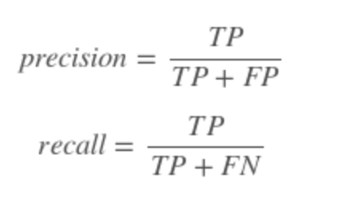
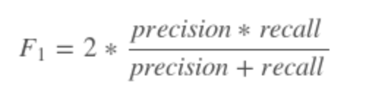
Models Built
< Classification Models >
Finding Proper Metrics
F1-score: harmonize average of recall and precision
Works well on imbalanced data
One over rest method, then weighted average
Balance between all the metrics
Priority: F1 score > AUC score > Accuracy
Notes:
Sally

Slide 20
Models Built
< Classification Models >
Hyperparameter Tuning
Gridsearch CV: test 72 combinations of principal parameters
Tune the model with the train data
Compare the baseline model and tuned model on the test data
learning rate: 0.3, 0.1, 0.01, 0.001
max_depth: 6, 12, 15, 18, 20, 25
n_estimator: 100, 500, 1000
72
Combinations
Notes:
Sally
Learning rate: the lower more shrinkage for each iteration -> prevent overfitting
Max_depth: the bigger -> tree get bigger and more likely to overfit
N_estimator;

Slide 21
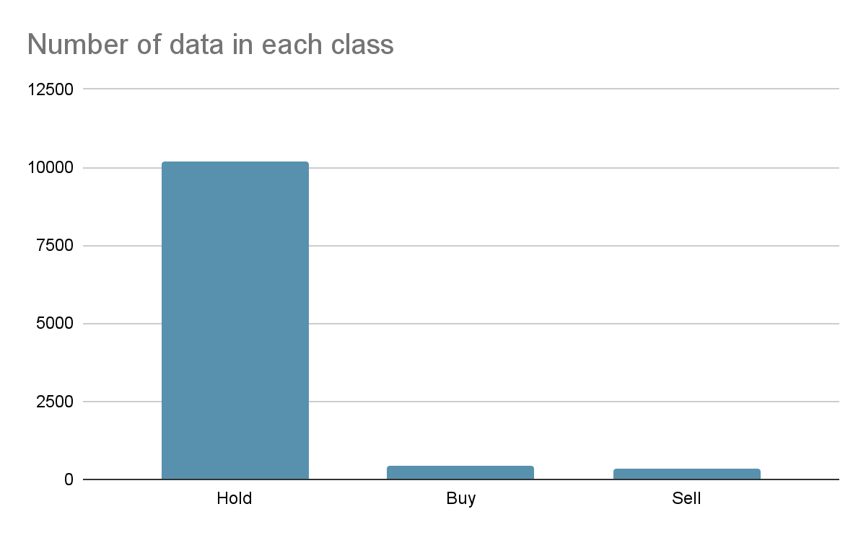
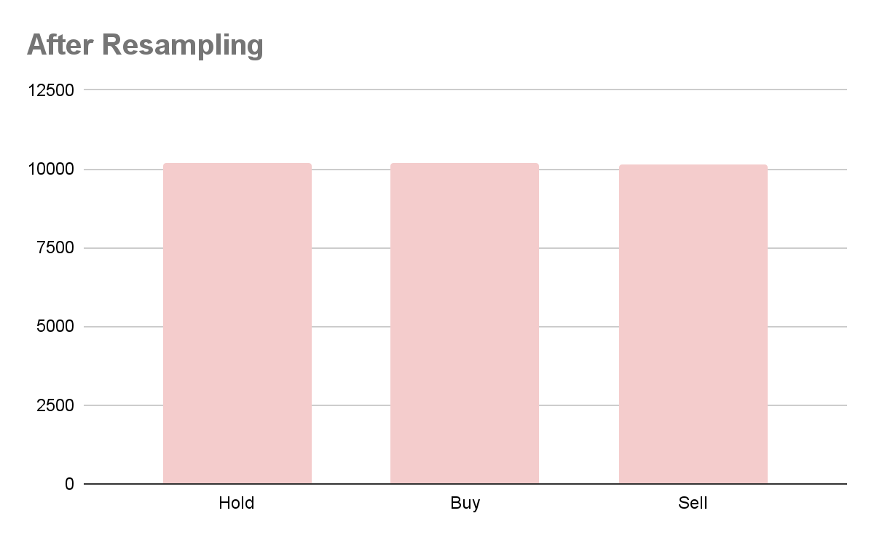
Models Built
< Classification Models >
Resampling the Data
Highly imbalanced in target variable
Used oversampling method to balance all tradable signals
< Example of Resampling results >
Dataset: ETF Approach: Aggressive
Notes:
Sally

Slide 22
Models Built
< Classification Models >
Expand to Other Datasets
Iterated the whole classification process to ETF and Retail MF data
Tried out 4 classification algorithms
Choose the best classifier based on F1 score, AUC, and Accuracy
< Number of Data Points>
70:30 Train-Test Split After Resampling | Institutional Mutual Funds |  | Retail Mutual Funds |  | ETF
 | Aggressive | Conservative | Aggressive | Conservative | Aggressive | Conservative
Train | 21,483 | 18,270 | 20,974 | 18,024 | 21,367 | 18,078
Test | 9,207 | 7,830 | 8,990 | 7,725 | 9,158 | 7,749
Total | 30,690 | 26,100 | 29,964 | 25,749 | 30,525 | 25,827
Notes:
Sally

Slide 23
Models Built
< Linear Regression Model >
Tried out 3 different linear regression models
Focused on Institutional Mutual Funds Dataset
Target variable: PortfolioChangePct of next week
Predictor variables: Flow, Flow_Pct, Asset End, and the 20 Asset Class Indicators
Metrics: R-squared, Mean Squared Error
 | Simple Linear Regression | Ridge Regression | Lasso Regression
R squared | - 0.005 | - 0.005 | - 0.0005
MSE | 8.522 | 8.522 | 8.484
→ Since the regression models had negative R-Squared, we decided to not move forward
with the linear regression model.
Notes:
Lujain

Slide 24
Models Built
<Neural Network Model>
First approach: Trained the model based on last week’s numbers
Y: Next week’s PortfolioChangePct
X: 4 remaining factors and 19 dummified asset classes
80/20 Train/Test Split: 8518 training and 2130 testing observations
<Neural Network Model with LSTM Architecture>
Model based a rolling window of time, separating the asset classes
Y: Next week’s PortfolioChangePct
X: 12 factors merged from all 3 datasets for the past 4 weeks
Trained each asset class separately as independent models
80/20 Training/Test Split
Notes:
Lujain
Original nn:
LSTM: combined all 3 different datasets, trained separate models for each asset class, number of assets classes times the 3 datasets; Rolling window timeline,

Slide 25
Models Built
<Time Series>
Tried out 4 different ARIMA models
Target variable: Predicted attribute of next week
Predictor variables: Flow, Flow_Pct, Assets End, PortfolioChangePct, and the 20 Asset Class Indicators
Metrics: Mean Squared Error
 | Flow | FlowPct | AssetsEnd | PortfolioChangePct
MSE Validation | 205544.9178 | 1.00580 | 0.14563 | 14979.75294
From the above results we see that FlowPct and AssetsEnd have the best predictions since they have the lowest MSE
Notes:
Shrey

Slide 26

Model Results
05
Notes:
Shrey

Slide 27
Model Results
<Classification - Aggressive Approach (Resampled Tuned)>
Metrics on Test Data | Institutional Mutual Funds | Retail Mutual Funds | ETF
Algorithm | XGBoost | XGBoost | XGBoost
F1 score | 67.50% | 69.68% | 66.43%
AUC score | 85.81% | 86.73% | 84.14%
Accuracy score | 67.77% | 70.1% | 67.68%
Actual Class | Buy: 3096 (33.63%) Hold: 3064 (33.28%) Sell: 3047 (22.23%) | Buy: 3026 (33.66%) Hold: 3003 (33.40%) Sell: 2961 (32.94%) | Buy: 3059 (33.40%) Hold: 3073 (33.56%) Sell: 3026 (33.04%)
Predicted Class | Buy: 4229 (45.93%) Hold: 2592 (28.15%) Sell: 2386 (25.92%) | Buy: 4199 (46.71%) Hold: 2636 (29.32%) Sell: 2155 (23.97%) | Buy: 4917 (53.69%) Hold: 2615 (28.55%) Sell: 1626 (17.75%)
Notes:
Shrey
Validation data -> added in the table header & priority between the metrics -> added in the previous section
How we will combine all the model
How to convince client ex)Feature importance (XGB has built-in attribute for this) -> added in next slides
True values vs prediction -> added in the table

Slide 28
Model Results
<Classification - Conservative Approach (Resampled Tuned)>
Metrics on Test Data | Institutional Mutual Funds | Retail Mutual Funds | ETF
Algorithm | XGBoost | XGBoost | XGBoost
F1 score | 76.72% | 75.90% | 75.45%
AUC score | 90.22% | 90.32% | 89.84%
Accuracy score | 76.82% | 75.91.% | 75.52%
Actual Class | Buy: 2590 (33.08%) Hold: 2611 (33.35%) Sell: 2629 (33.58%) | Buy: 2588 (33.50%) Hold: 2558 (33.11%) Sell: 2579 (33.39%) | Buy: 2582 (33.32%) Hold: 2618 (33.79%) Sell: 2549 (32.89%)
Predicted Class | Buy: 2562 (32.72%) Hold: 2827 (36.10%) Sell: 2441 (31.17%) | Buy: 2568 (33.24%) Hold: 2655 (34.37%) Sell: 2502 (32.39%) | Buy: 2480 (32.00%) Hold: 2777 (35.84%) Sell: 2492 (32.16%)
Notes:
Shrey

Slide 29
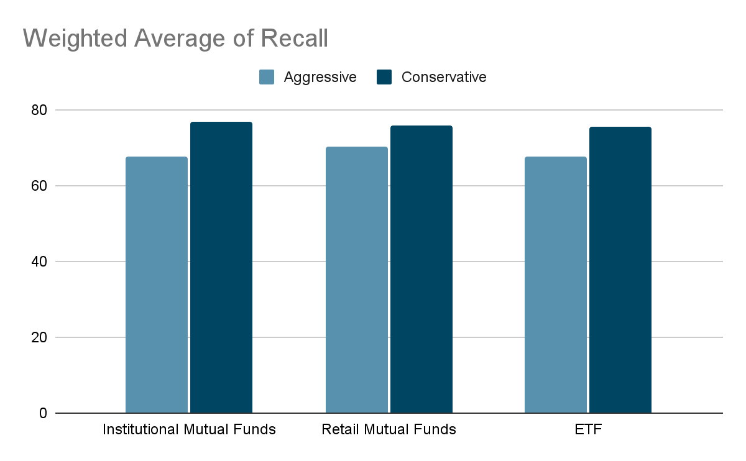
Model Results
<Classification - Confidence Level>
Notes:
Shrey
Recall is true positive rate
High recall = low false negative

Slide 30
Model Results
<Regression - Linear Regressions>
Metric | Simple Linear | Ridge Linear | Lasso Linear
R squared | - 0.005 | - 0.005 | - 0.0005
Mean Squared Error | 8.522 | 8.522 | 8.484
Number of signal based on prediction (Aggressive) | Buy: 0 (0%) Hold: 3300 (100%) Sell: 0 (0%) | Buy: 0 (0%) Hold: 3300 (100%) Sell: 0 (0%) | Buy: 0 (0%) Hold: 3300 (100%) Sell: 0 (0%)
Number of signal based on prediction (Conservative) | Buy: 0 (0%) Hold: 3300 (100%) Sell: 0 (0%) | Buy: 0 (0%) Hold: 3300 (100%) Sell: 0 (0%) | Buy: 0 (0%) Hold: 3300 (100%) Sell: 0 (0%)
Notes:
Lujain

Slide 31
Model Results
<Neural Network Model>
<With LSTM Architecture>
 | Institutional Mutual Funds | ETF | Retail Mutual Funds
MSE | 1.9650 | 1.9765 | 1.8640
Validation MSE | 1.9309 | 2.0788 | 1.8894
R squared | -0.0039 | -0.1563 | -0.0120
 | Institutional Mutual Funds | ETF | Retail Mutual Funds
MSE | 5.426 | 5.615 | 4.996
Validation MSE | 5.845 | 5.844 | 5.721
R squared | -0.1469 | -0.3101 | -0.912
→ Neural Network models have a negative R-Squared; this indicates bad performance done by the explanatory variables to predict the target variable.
Notes:
Lujain

Slide 32
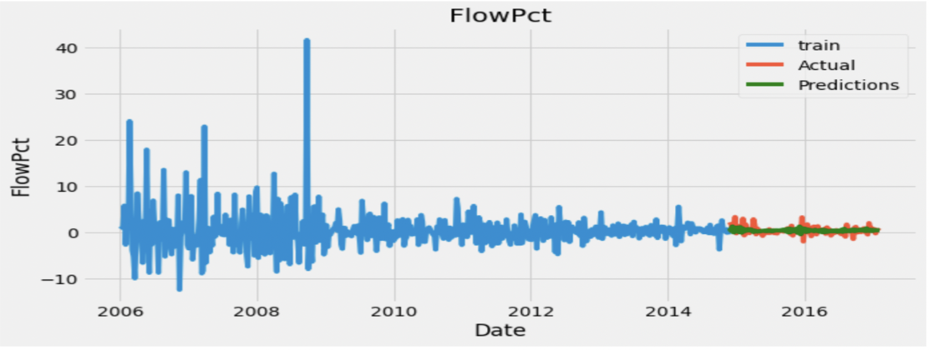
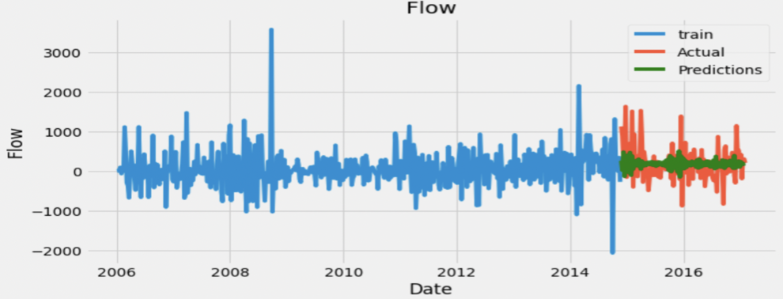
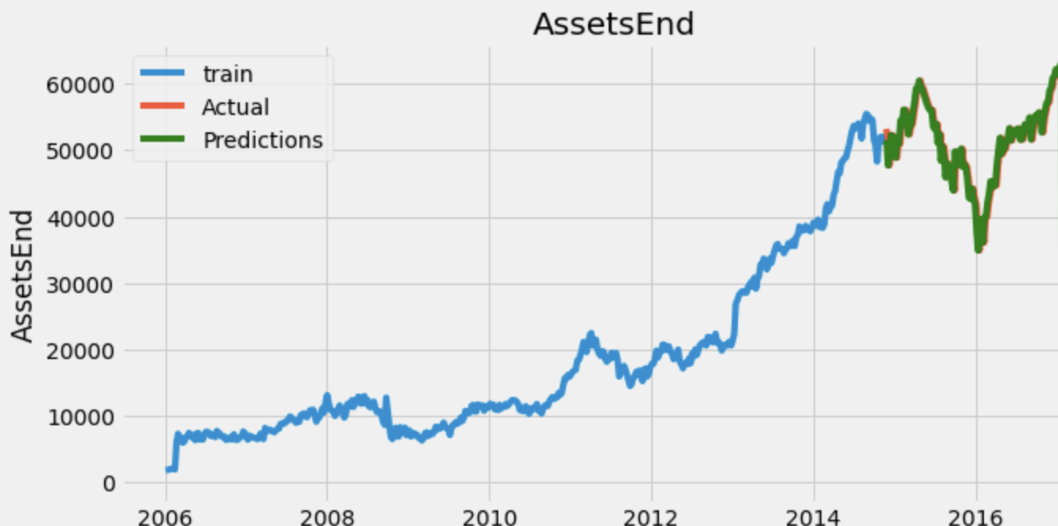
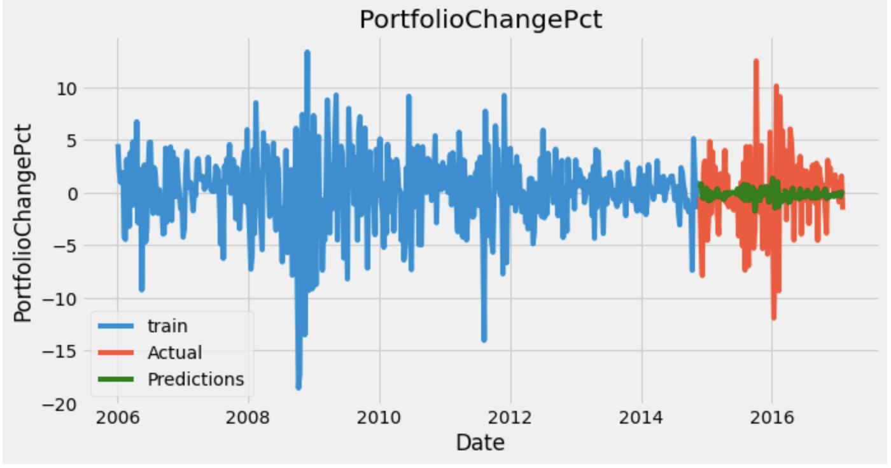
Model Results
<Time Series>
Notes:
Lujain

Slide 33

Limitations
06
Notes:
Lujain

Slide 34

Some Limitations to Consider when Building the Models
Limited Data - Not Enough Predictive Variables
Time Constraints
Not enough subdivided tradable signals
Unpredictability of Stock Data
Notes:
Lujain

Slide 35
Recommendations & Conclusion
07
Notes:
David

Slide 36

Final Recommended Model
Resampled Tuned Classification Model
Notes:
David

Slide 37
Use-Case Scenario
the observation with these values:
We can provide investment strategies and asset class reports using weekly probability predictions of a tradable signal.
For example, in our Retail MF Conservative Approach dataset model, we got the following predictive probabilities:
For the observation with these values:
Sell | Hold | Buy
13.38% | 20.12% | 66.50%
Asset Class | Flow Pct | Flow | Assets End
Commodities/Materials-North America-USA-North America-Equity | -6.68% | 0.33 | -0.64
* Flow and AssetsEnd are scaled
Notes:
David
F1 AUC
Example data: Retail Mutual Fund, conservative approach Asset class = AssetClass_Commodities/Materials-North America-USA-North America-Equity
FlowPCT: -0.066824
Flow_scaled: 0.330908
assetsend_scaled: -0.637980

Slide 38
Conclusion
In conclusion, the best model to help determine a tradable signal in the dataset is the tuned resampled classification model.
Even though it was the best option from what was available, it is important to note that predicting future stock events is almost impossible to do.
Notes:
David

Slide 39

Future Enhancement Recommendations
Adding more financial characteristic variables into our datasets
Include more subdivided tradable signals.
Try more advanced modeling methods
At the moment, we only had 5 different predictive variables in our dataset. Given the unpredictability of the stock market, a lot more financial data would be needed to help determine a tradable signal.
Instead of Buy/Hold/Sell, we can create more divisions, such as Strong Buy/Weak Buy, Strong Sell/Weak Sell, and Hold.
Some examples could be transfer learning or more in-depth neural networks, etc.
Notes:
David

Slide 40

Thank
You!
Notes:
David

